Slide 1






Bootcamp
Jobs in IT
BASIC LEVEL
CAROLINA GOMEZ M.
MAY 21st,2024

Slide 2
Table of content
1
Review
2
Jobs in IT
3
Practice

Slide 3
1. REVIEW
What did we do last class?
Famous people in IT
New Vocabulary
Verbs in past
https://www.liveworksheets.com/node/5347471
https://wordwall.net/es/resource/34704781/crossword-past-simple-verbs
Notes:
Verbs in past review: https://wordwall.net/es/resource/34704781/crossword-past-simple-verbs

Slide 4

2. JOBS IN IT
Which positions in IT do you know?
Play here
https://thewordsearch.com/puzzle/6824944/it-jobs/
Notes:
Game: https://thewordsearch.com/puzzle/6824944/it-jobs/

Slide 5


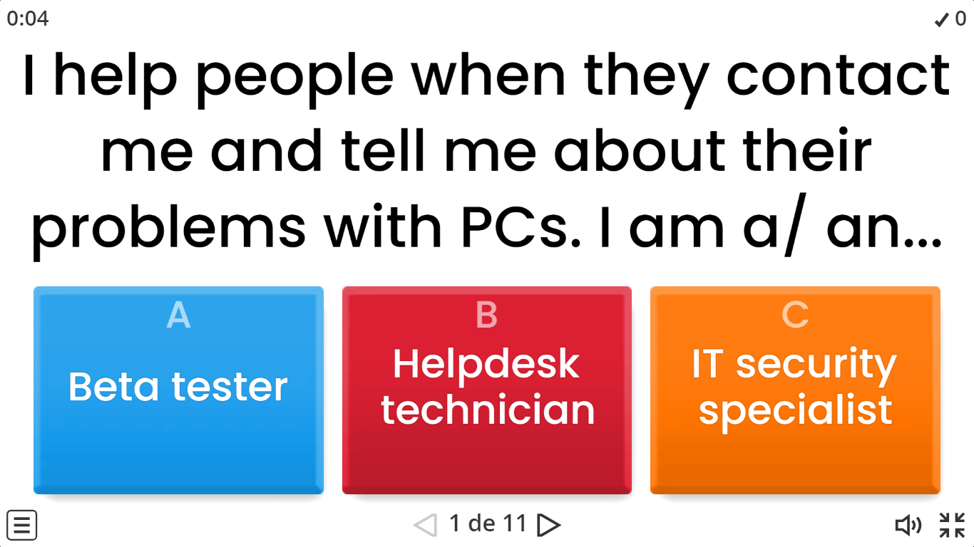
VOCABULARY ACTIVITY # 1
https://wordwall.net/es/resource/37103225/idioma-en-ingl%C3%A9s/it-jobs

Slide 6
Let’s read!
What is an IT Job?
An IT job is, most commonly, some type of computer support job. The job titles for IT jobs could be Desktop Support Engineer, Computer Consultant, Programmer Analyst, LAN Engineer, WAN Engineer, Network Security Consultant, Database Programmer, CIO (chief information officer), Systems Administrator, Microsoft Administrator, Unix Systems Administrator. The combination of job titles in IT are virtually endless. These previous ones are some of the top categories of IT jobs.

Slide 7


What would a person with an IT job do?
Someone with an IT job would most commonly work for a company in their Information Technology department. This person would support the office staff of employees as it relates to their computers. Everyone in an office most likely uses a computer.
Most people don’t know what to do when their computer breaks, needs a tune up, needs software updates, or how to move their information from one computer to a new one. This is when a person with an IT job appears. This IT person will know how to fix computer problems for the office staff so the office staff can do their job.
Another example of what a person with an IT job would do is manage the network servers for a company. Network servers are the backbone of a company’s business. For all those office workers who use PC Computers, all their information and data is stored on a much larger and more powerful computer called a server. Network servers do everything. They store data, they make sharing data easy so everyone in the company can access it.
Notes:
Answers to the comprehension questions:
1. Bob's main concern regarding robots and automation is that they will take over jobs, leading to unemployment and potentially causing societal upheaval.
2. The speaker counters Bob's concerns by pointing out that technological advancements have historically led to increased efficiency and prosperity, and that humans have adapted to these changes by learning new skills.
3. The speaker uses the example of the Industrial Revolution to illustrate the impact of technological advancements on employment, highlighting how automation has led to fewer people working fewer hours to achieve greater prosperity.
4. Some benefits of automation mentioned in the text include increased efficiency, reduced workload, and the ability to perform tasks that are difficult, dirty, dangerous, or time-consuming.
5. The speaker suggests that humans adapt to technological advancements by learning new skills and finding new opportunities, ultimately benefiting from having their previous jobs done by machines.

Slide 8
Network servers are very important to businesses and when they are not working right, the business could potentially lose millions of dollars. This is why they hire specially trained people for these IT jobs. These IT professionals are specially trained to keep the IT department working 24/7.
How do you get a Programming job in IT?
There are many different programming languages. There is PHP, DB2, Cobol, C, Pearl, Oracle, SQL. The list is practically endless of programming languages. To get a programming job in IT, you would need to study that particular programming language on your own, in college or through online classes. Getting a programming job in IT is a great start for people who have strong math and analytical skills.

Slide 9
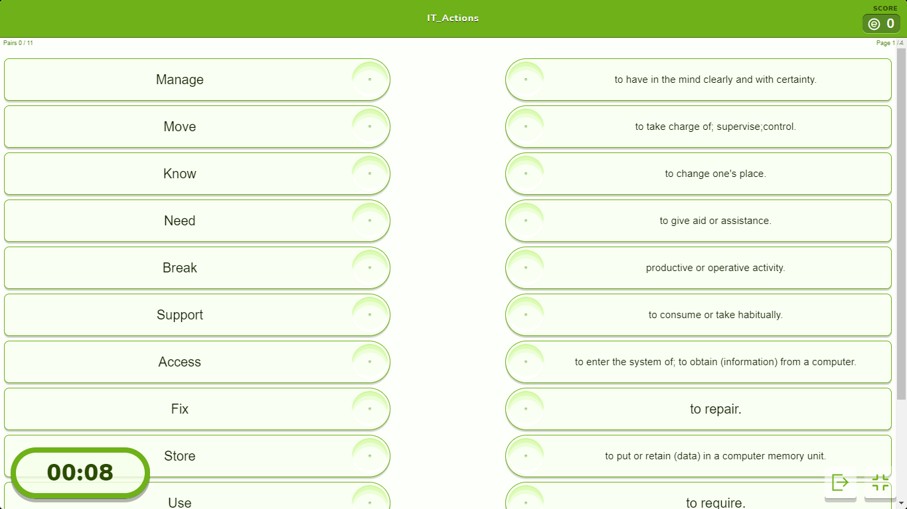
VOCABULARY ACTIVITY # 2
IT_Actions
Match the words (on the right) to its corresponding definition (on the left).
https://es.educaplay.com/recursos-educativos/18398539-it_actions.html
Notes:
1. Automation
2. Unemployment
3. Taxation
4. Industrial Revolution
5. Displaced workers
6. Witchcraft
7. Efficiency
8. Transition

Slide 10
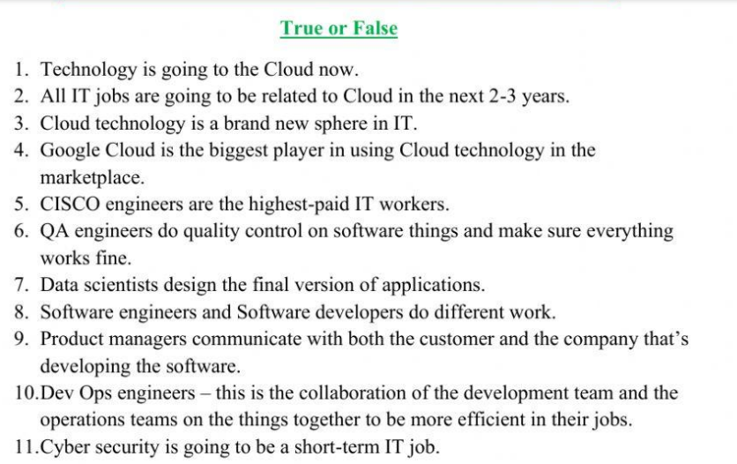
VIDEO ACTIVITY
Watch the video and answer TRUE or FALSE
https://www.liveworksheets.com/w/en/english-second-language-esl/351252
Notes:
1. Automation
2. Unemployment
3. Taxation
4. Industrial Revolution
5. Displaced workers
6. Witchcraft
7. Efficiency
8. Transition

Slide 11
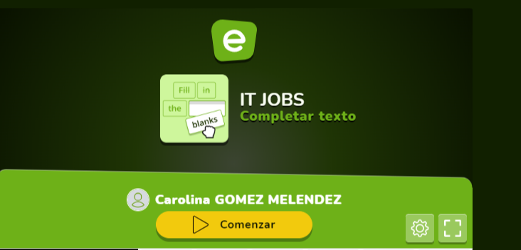
REINFORCEMENT ACTIVITY # 1
https://es.educaplay.com/recursos-educativos/18400537-it_jobs.html

Slide 12
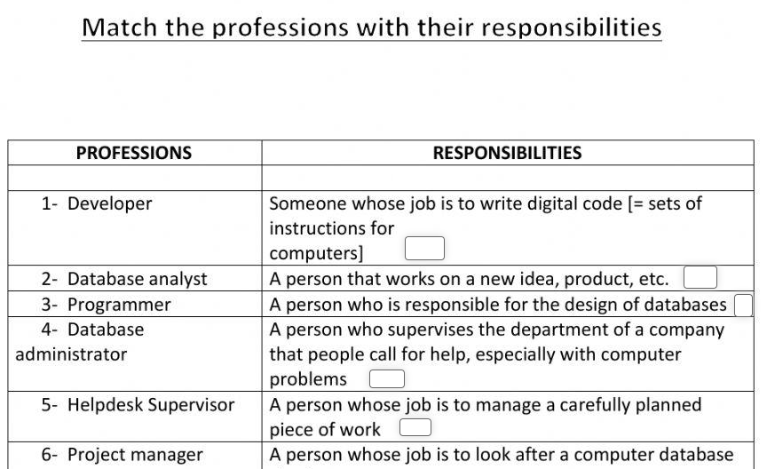
REINFORCEMENT ACTIVITY # 2
https://www.liveworksheets.com/w/en/it/1960746

Slide 13

Present an IT position (Poster)
From Vocabulary Activity # 1, choose an IT Job and create a poster with the following information about it.
Describe the job/ position.
Responsibilities.
Advantages.
Disadvantages.
Skills required.
Notes:
Useful links:
https://www.indeed.com/career-advice/finding-a-job/types-of-it-jobs
https://www.jobtrainworks.org/career-advancement/it-occupations/types-of-it-jobs/

Slide 14
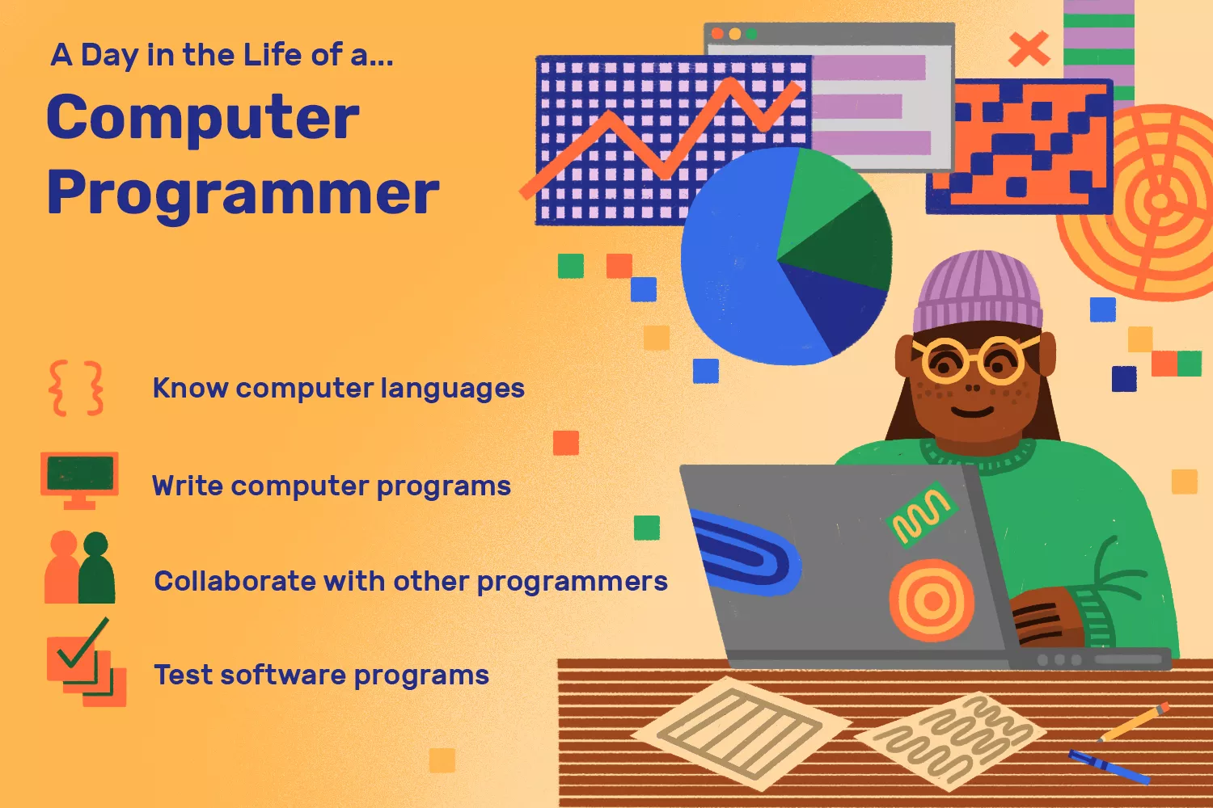
Oral Presentation
Example:
Notes:
Game: https://thewordsearch.com/puzzle/6824944/it-jobs/

Slide 15
Oral Presentation
Make groups of three or four people.
Find information about an IT job.
Create a poster.
Present your work to the rest of the class.
Notes:
EXTRA ACTIVITY: https://thewordsearch.com/puzzle/6824944/it-jobs/

Slide 16


